Slide 1
Advanced Data Analysis
Emanuele Della Valle
Prof. @ Politecnico di Milano
Founder & Partner @ Quantia Consulting
Marco Balduini
Founder & CEO @ Quantia Consulting
Riccardo Tommasini
Prof. @ University of Tartu

Slide 2
Exploring flux map()

Slide 3
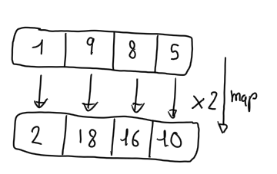
Map()
How does it work?
It applies a function to each element of a collection
e.g., double each number
What’s for?
Combine data
Derive data
Enrich data
Clean data
…
Turn data into information!

Slide 4
Map() in flux
:o
The map() function applies a function to each record in the input tables
The modified records are assigned to new tables based on the group key of the input table

Slide 5
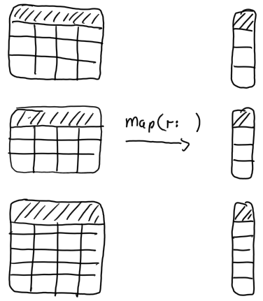
Combine/derive data with map()

Slide 6
_time | _m | _field | _value
10:45 | cpu | system | 1000
11:45 | cpu | system | 3000
GroupKey[cpu, system]
hour
10
11
_time | _m | _field | _value
11:00 | cpu | system | 2000
11:30 | cpu | system | 2000
GroupKey[cpu, system]
map(fn: (r) => ({ hour: date.hour(t: r._time) }))
hour
11
11
_time | _m | _field | _value
10:35 | cpu | idle | 100
GroupKey[cpu, idle]
hour
10
_time | _m | _field | _value
11:15 | cpu | idle | 200
11:50 | cpu | idle | 400
GroupKey[cpu,, idle]
hour
11
11

Slide 7
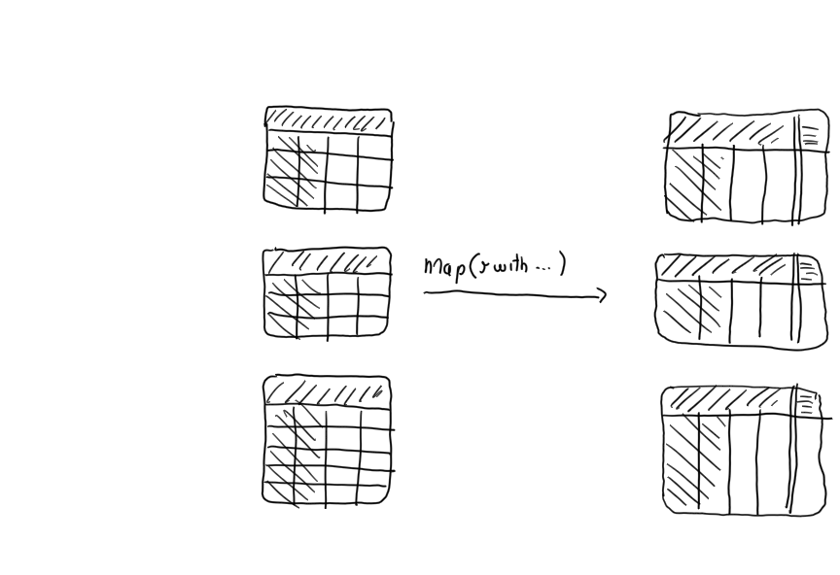
Enrich data using map(r with … )

Slide 8
_time | _m | _field | _value
10:45 | cpu | system | 1000
11:45 | cpu | system | 3000
GroupKey[cpu, system]
_time | _m | _field | _value | hour
10:45 | cpu | system | 1000 | 10
11:45 | cpu | system | 3000 | 11
GroupKey[cpu, system]
_time | _m | _field | _value
11:00 | cpu | system | 2000
11:30 | cpu | system | 2000
GroupKey[cpu, system]
map(fn: (r) => ({ r with hour: date.hour(t: r._time) }))
_time | _m | _field | _value | hour
11:00 | cpu | system | 2000 | 11
11:30 | cpu | system | 2000 | 11
GroupKey[cpu, system]
_time | _m | _field | _value
10:35 | cpu | idle | 100
GroupKey[cpu, idle]
_time | _m | _field | _value | hour
10:35 | cpu | idle | 100 | 10
GroupKey[cpu, idle]
_time | _m | _field | _value
11:15 | cpu | idle | 200
11:50 | cpu | idle | 400
GroupKey[cpu,, idle]
_time | _m | _field | _value | hour
11:15 | cpu | idle | 200 | 11
11:50 | cpu | idle | 400 | 11
GroupKey[cpu,, idle]

Slide 9
Clean data using map(r with … )

Slide 10
_time | _m | _field | _value
10:45 | cpu | system | 1000
11:45 | cpu | system | 3000
GroupKey[cpu, system]
_time | _m | _field | _value
10:45 | cpu | system | 33.3%
11:45 | cpu | system | 100%
GroupKey[cpu, system]
_time | _m | _field | _value
11:00 | cpu | system | 2000
11:30 | cpu | system | 2000
GroupKey[cpu, system]
map(fn: (r) => ({ r with _value : r._value/3000.0 }))
_time | _m | _field | _value
11:00 | cpu | system | 66.6%
11:30 | cpu | system | 66.6%
GroupKey[cpu, system]
_time | _m | _field | _value
10:35 | cpu | idle | 100
GroupKey[cpu, idle]
_time | _m | _field | _value
10:35 | cpu | idle | 3.3%
GroupKey[cpu, idle]
_time | _m | _field | _value
11:15 | cpu | idle | 200
11:50 | cpu | idle | 400
GroupKey[cpu,, idle]
_time | _m | _field | _value
11:15 | cpu | idle | 6.6%
11:50 | cpu | idle | 13.3%
GroupKey[cpu,, idle]

Slide 11
Exploring flux Custom Functions

Slide 12
Recall: What Is Flux?
Flux is a functional data scripting and query language
Written to be:
Useable: easy to learn
Readable: developers read more code than we write
Composable: developers can build onto the language
Testable: queries are code
Contributable: open source contributions matter

Slide 13
Defining and using a custom function
Syntax
<<function name>> = (<<variable>>*) => <<implementation>>
Example
squared = (r) => r*r
from(bucket:"foo")
|> range(start: -1h)
|> filter(fn: (r) => r._measurement == "samples")
|> map(fn: (r) => ({ _value: squared(r._value)}))
|> filter(fn: (r) => r._value > 23.2)

Slide 14
Defining a custom pipe forwardable function
Syntax
<<function name>> = (<<table>>=<-, <<variable>>*) => <<table>> |> << implementation >>
Example
allSquared = (tables=<-) =>
tables |> map(fn: (r) => squared(r._value))
from(bucket:"foo")
|> range(start: -1h)
|> filter(fn: (r) => r._measurement == "samples")
|> allSquared()
|> filter(fn: (r) => r._value > 23.2)

Slide 15

Let’s get dirty!
7

Slide 16
Continuous Linear Pizza Oven
Learning goals:
Map functions
Custom functions
s2
s1

Slide 17
Task
Correct the temperature observations of the cooking base area by by subtracting a delta of 5°C to each value
Use an inline map
Create a custom function to be used in the inline map
Create a custom pipe forwardable function that contains a map

Slide 18
Quiz
True or false
in a functional programming language, map() applies a function to each element of a collection – ?
in Flux, map() always adds a column to each table – ?
map() using the with clause can add a column to each table – ?
you can pass a custom functions only to a map() – ?
in a pipe-forwardable custom function with a parameter (t=<-), t represents input tables that the function applies to – ?

Slide 19
Quiz answers
True or false
in a functional programming language, map() applies a function to each element of a collection – T
in Flux, map() always adds a column to each table – F
map() using the with clause can add a column to each table – T
you can pass a custom functions only to a map() – F
in a pipe-forwardable custom function with a parameter (t=<-), t represents input tables that the function applies to – T

Slide 20
Exploring flux Joining Time Series

Slide 21
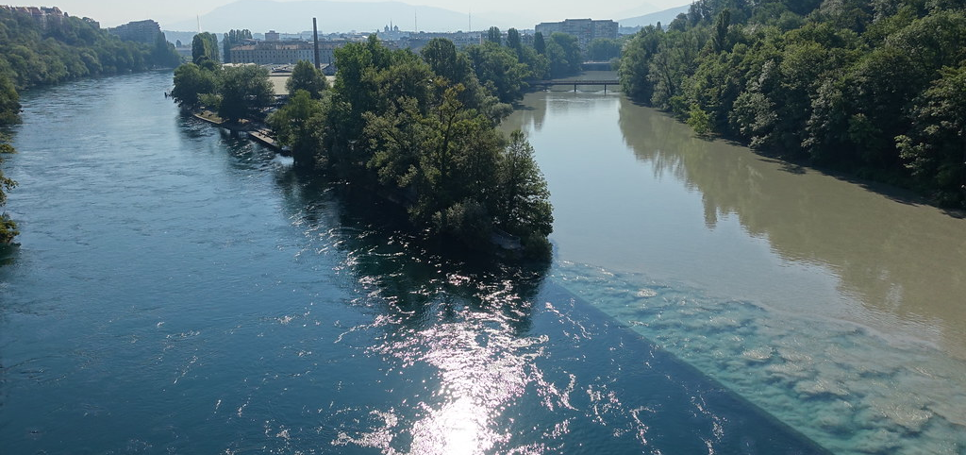
Joining two time series

Slide 22
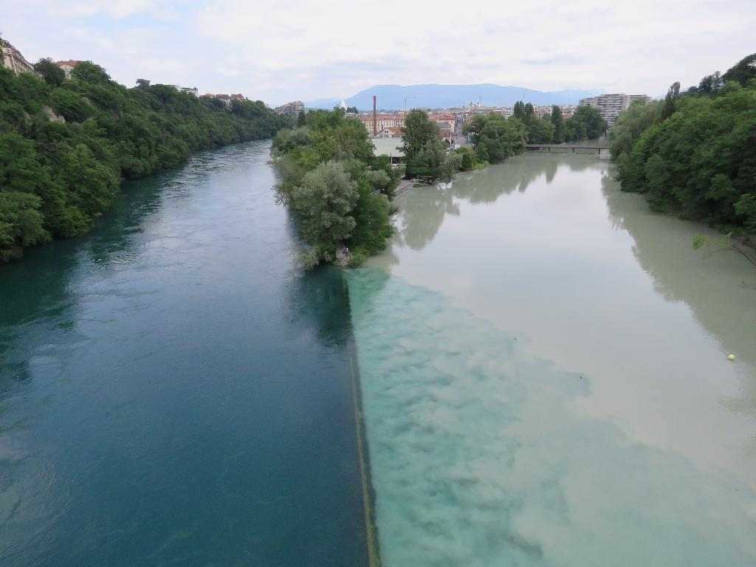
The ideal case

Slide 23
Running example on pizza quality issues
If the temperature difference between the base cooking area and the mozzarella melting area is lower than 180° or greater than 190°, the mozzarella cheese will not melt properly or it will burn.

Slide 24
Ok … sounds easy
305
290
285
S1
280
280
00:00
01:00
02:00
03:00
04:00
120
105
110
S2
100
95
00:00
01:00
02:00
03:00
04:00
S1-S2
185
185
185
185
170
00:00
01:00
02:00
03:00
04:00

Slide 25
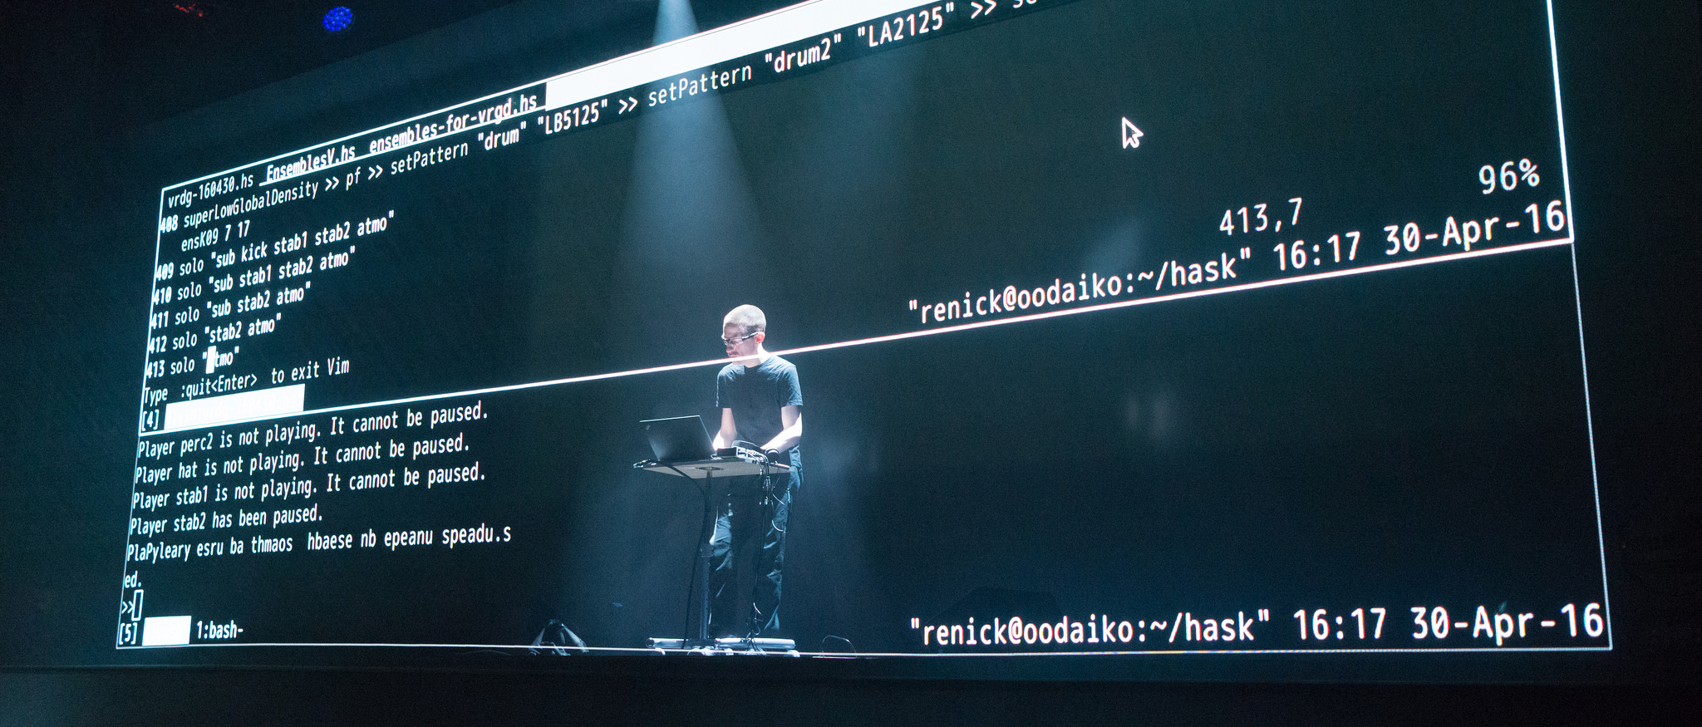
Let’s do some live coding

Slide 26
Here we go
ts12 = from(bucket: "training")
|> range(start: 2020-06-07T12:00:00Z, stop: 2020-06-07T12:05:00Z)
|> filter(fn: (r) => r._measurement == "iot-oven")
|> filter(fn: (r) => r._field == "temperature")
ts1 = ts12 |> filter(fn: (r) => r.sensor == "S1")
ts2 = ts12 |> filter(fn: (r) => r.sensor == "S2")
join(tables: {key1: ts1, key2: ts2}, on: ["_time"], method: "inner")
join |> map(fn: (r) => ({ _time: r._time,
_value: r._value_s1 - r._value_s2 }))

Slide 27
It gives no results … why?
:-/

Slide 28
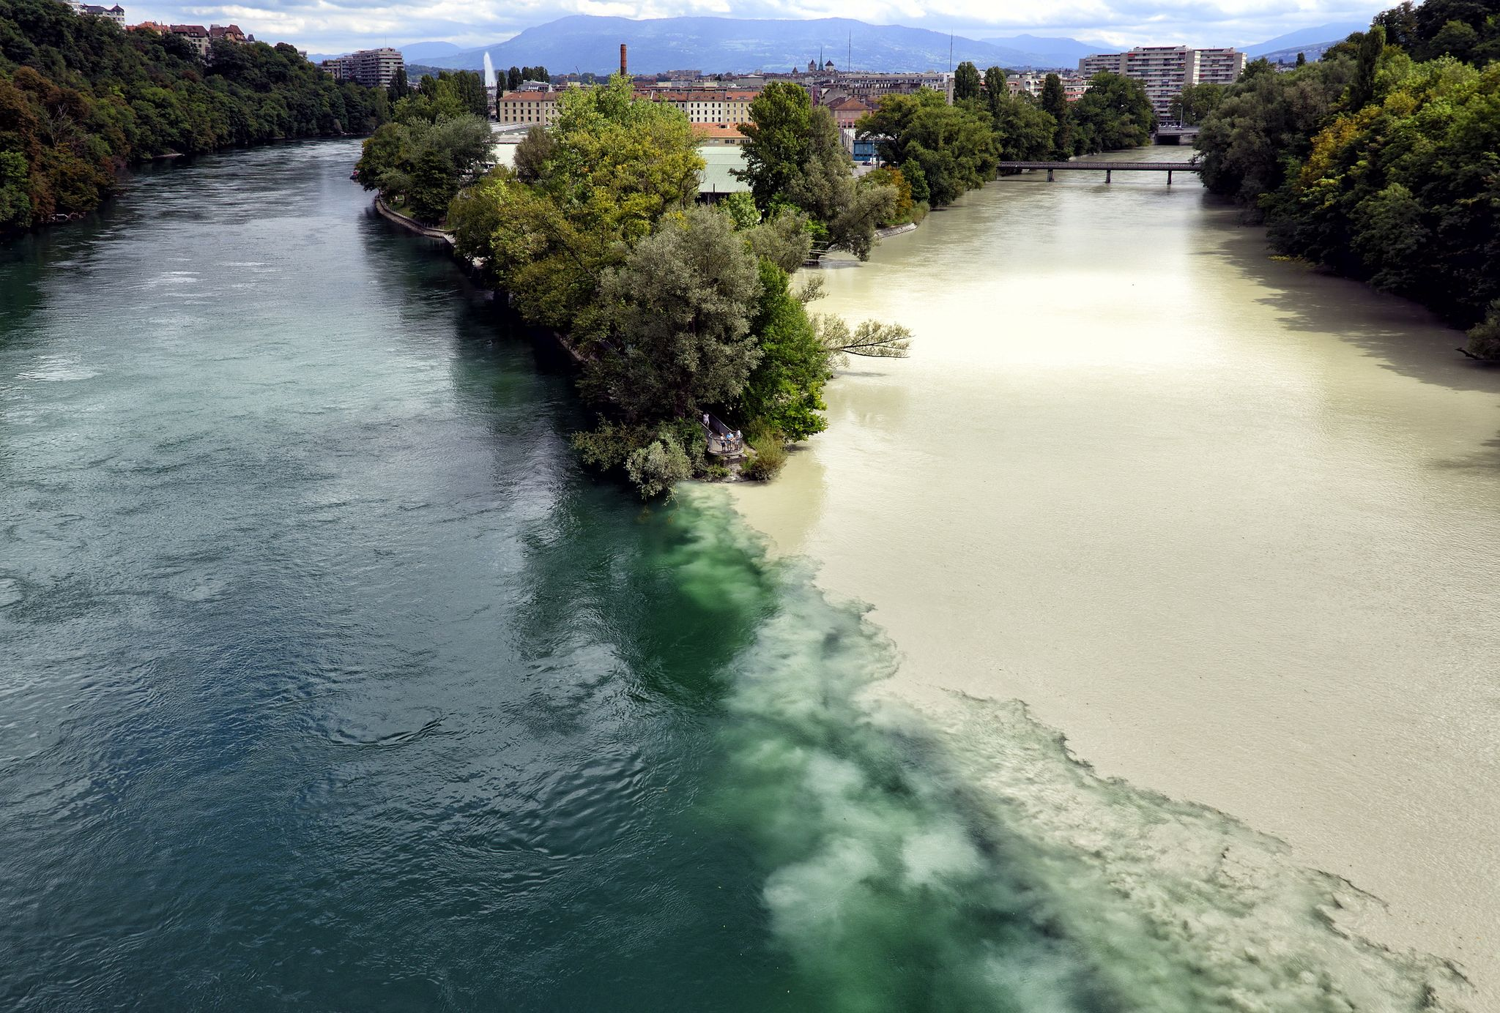
The reality is always more difficult than expected

Slide 29
A close look to the distribution of our data over time
305
290
285
S1
280
280
00:00
01:00
02:00
03:00
04:00
120
115
115
105
110
110
S2
100
95
90
00:15
00:45
01:15
01:45
02:15
02:45
03:15
03:45
04:15
NOTE: S1 and S2 are not synchronized: metrics don’t occur at the same time and rate
Notes:
Time shift
ma ci sono riuscito solo perchè potevo ispezionare I dati
trunchiamo?
Valori multipli|!!!
E allora?
aggregate window

Slide 30

Can we synchronize them? Let’s do a time shift!

Slide 31
Can we synchronize them with a time shift?
305
290
285
S1
280
280
00:00
01:00
02:00
03:00
04:00
120
115
115
105
110
110
S2
-15 sec
100
95
90
00:15
00:45
01:15
01:45
02:15
02:45
03:15
03:45
04:15

Slide 32
Here we go
temp = from(bucket: "training")
|> range(start: 2020-01-01T00:00:00Z, stop: 2020-01-01T00:05:00Z)
|> filter(fn: (r) => r._measurement == "iot-oven")
|> filter(fn: (r) => r._field == "temperature")
tempS1 = temp |> filter(fn: (r) => r.sensor == "S1")
tempS2 = temp |> filter(fn: (r) => r.sensor == "S2")
|> timeShift(duration: 15s, columns: ["_time"] )
join = join( tables: {s1:tempS1, s2: tempS2}, on: ["_time"] )
join |> map(fn: (r) => ({ _time: r._time,
_value: r._value_s1 - r._value_s2 }))

Slide 33
Can we synchronize them with a time shift?
305
290
285
S1
280
280
00:00
01:00
02:00
03:00
04:00
120
115
115
105
110
110
S2
100
-15 sec
95
90
00:00
00:30
01:00
01:30
02:00
02:30
03:00
03:30
04:00
NOTE: some metrics now occur at the same time, but the rate is still different

Slide 34
Moreover, is -15 sec correct? Shall I do -30 sec, instead?
:-/

Slide 35

Shall we tumble?

Slide 36
Can we synchronize them with a tumbling window?
305
290
285
S1
280
280
00:00
01:00
02:00
03:00
04:00
120
115
115
105
110
110
S2
100
95
90
00:15
00:45
01:15
01:45
02:15
02:45
03:15
03:45
04:15
NOTE: S1 and S2 are not synchronized: metrics do not occur nor at the same to nor rate

Slide 37
Can we synchronize them with a tumbling window?
305
290
285
S1
280
280
00:00
01:00
02:00
03:00
04:00
120
115
115
105
110
110
S2
100
95
90
00:15
00:45
01:15
01:45
02:15
02:45
03:15
03:45
04:15
NOTE: S1 and S2 are not synchronized: metrics do not occur nor at the same to nor rate

Slide 38
Can we synchronize them with a tumbling window?
305
290
285
S1
280
280
00:00
01:00
02:00
03:00
04:00
120
115
115
105
110
110
S2
100
95
90
00:15
00:45
01:15
01:45
02:15
02:45
03:15
03:45
04:15
NOTE: S1 and S2 are not synchronized: metrics do not occur nor at the same to nor rate

Slide 39
Here we go
temp = from(bucket: "training")
|> range(start: 2020-04-30T10:00:00Z, stop: 2020-04-30T10:05:00Z)
|> filter(fn: (r) => r._measurement == "iot-oven")
|> filter(fn: (r) => r._field == "temperature")
tempS1 = temp |> filter(fn: (r) => r.sensor == "S1")
|> aggregateWindow(every: 60s, fn: mean)
tempS2 = temp |> filter(fn: (r) => r.sensor == "S2")
|> aggregateWindow(every: 60s, fn: mean)
join = join( tables: {s1:tempS1, s2: tempS2}, on: ["_time"] )
join |> map(fn: (r) => ({ _time: r._time,
_value: r._value_s1 - r._value_s2 }))

Slide 40
It works!
:-)

Slide 41
Bonus point: tumbling windows also synchronize events!
305
290
285
S1
280
280
00:09
01:06
02:04
03:02
04:07
120
115
115
105
110
110
S2
100
95
90
00:12
00:46
01:21
01:39
02:17
02:36
03:16
03:48
04:18
MENO: events are irregular time series

Slide 42
Bonus point: tumbling windows also synchronize events!
305
290
285
S1
280
280
00:09
01:06
02:04
03:02
04:07
120
115
115
105
110
110
S2
100
95
90
00:12
00:46
01:21
01:39
02:17
02:36
03:16
03:48
04:18
MENO: events are irregular time series

Slide 43
Bonus point: tumbling windows also synchronize events!
305
290
285
S1
280
280
00:09
01:06
02:04
03:02
04:07
120
115
115
105
110
110
S2
100
95
90
00:12
00:46
01:21
01:39
02:17
02:36
03:16
03:48
04:18
MENO: events are irregular time series

Slide 44
Quiz
Which synchronization method shall you use before joining? none | timeShift | aggregateWindow
one timeseries is regular, but the other is not - ?
two timeseries are regular, have the same rate, but metrics occur at a different time - ?
two timeseries are regular, have the same rate, and metrics occur at the same time - ?
two timeseries are irregular - ?
two timeseries are regular, but metrics don't occur at the same time and rate - ?

Slide 45
Quiz answers
Which synchronization method shall you use before joining? none | timeShift | aggregateWindow
one timeseries is regular, but the other is not - aggregateWindow
two timeseries are regular, have the same rate, but metrics occur at a different time - timeShift
two timeseries are regular, have the same rate, and metrics occur at the same time - none
two timeseries are irregular - aggregateWindow
two timeseries are regular, but metrics don't occur at the same time and rate - aggregateWindow

Slide 46
Let’s get dirty!
8

Slide 47
Continuous Linear Pizza Oven
Learning goals:
Join data
s2
s1

Slide 48
Task
Extract the difference between the humidity levels of the base cooking area and the mozzarella melting area. Find if the differences are lower than 20% or greater than 30%

Slide 49
Advanced Data Analysis
Emanuele Della Valle Prof. @ Politecnico di Milano & Partner @ Quantia Consulting
Marco Balduini Founder & CEO @ Quantia Consulting
Riccardo Tommasini Prof. @ University of Tartu

